Slide 1
Mass Shootings in the U.S and Mental Illness
Heer, Abigail, Nishan, Thao, and Sarah
DATA 201: Thinking with Data

Slide 2
Introduction
In recent years, mass shootings have occurred with an increasing number in frequency and corresponding severity within the United States.
The Gun Violence Archive, a daily database tracking gun violence in the U.S, defines mass shootings as “any incident in which at least four people are shot, excluding the shooter.” (Silverstein 2020).
According to the Gun Violence Archive, there are a total of 650 mass shootings in the U.S as of November 30th, 2021. From gun violence overall, the total number of injuries stand at 37, 314, and the death toll stands at 1,986.

Slide 3
Goal
To study data on mass shootings to highlight the relationship between gun violence and factors to gun violence: gun laws (at the time of the shooting), mental health, race, sex, age, and relation to the shooting place.
In addition to highlighting the relationship, our goal is to determine what the relationship has on the implications of public safety and rights in the U.S.
By understanding the connection between gun violence and the other factors pertaining to gun violence, primarily related to mental health, the U.S government can form policies to prevent gun violence and the number of casualties and injuries.

Slide 4
OBTAINING THE DATA

Slide 5
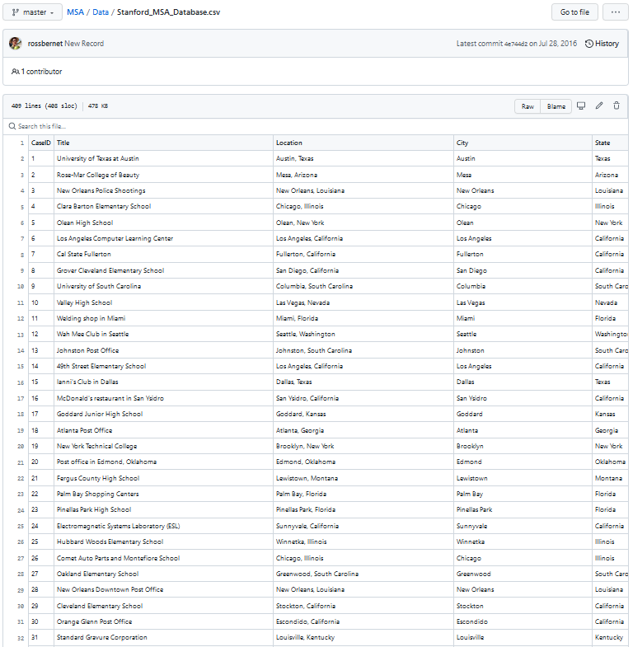
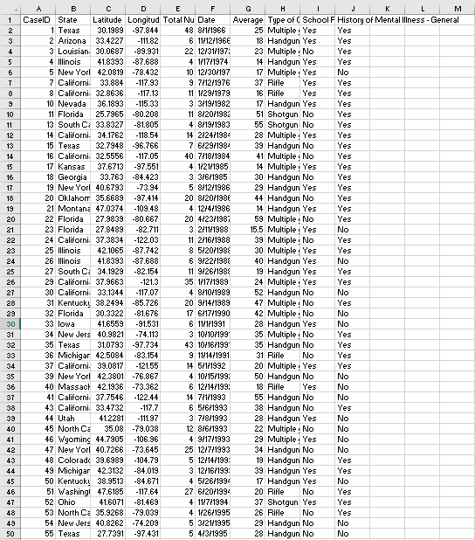
MSA(Mass Shootings In America)

Slide 6
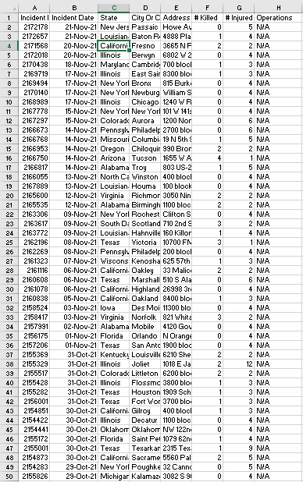
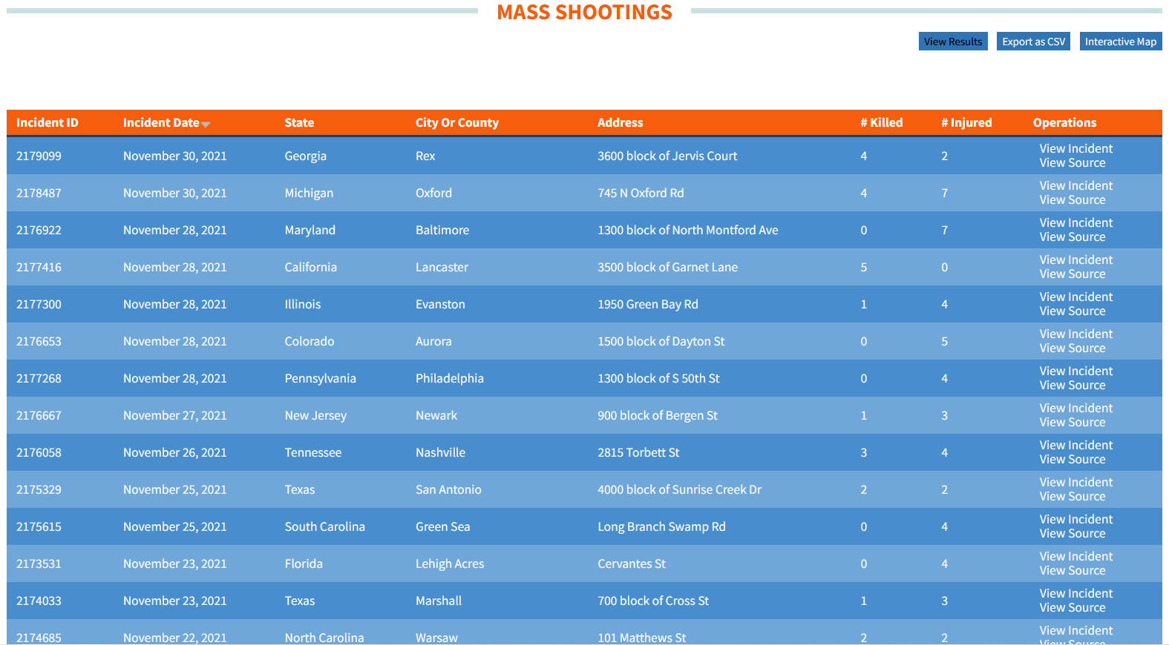
Gun Violence Archive

Slide 7
CLEANING DATA

Slide 8
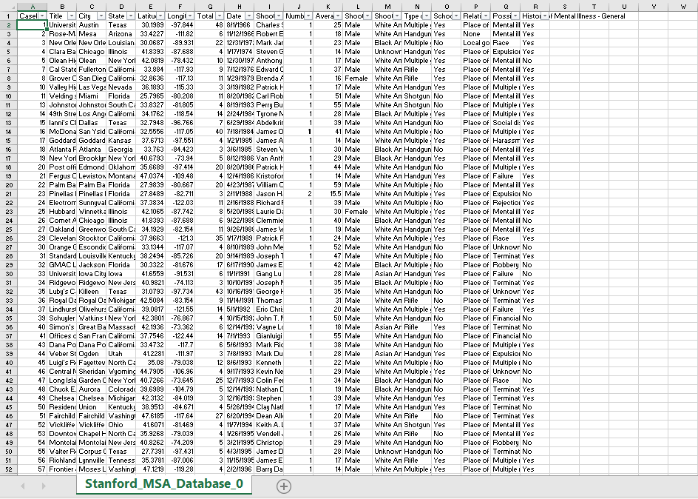
Finalized Dataset
Gun Archive Database
Stanford MSA Database

Slide 9
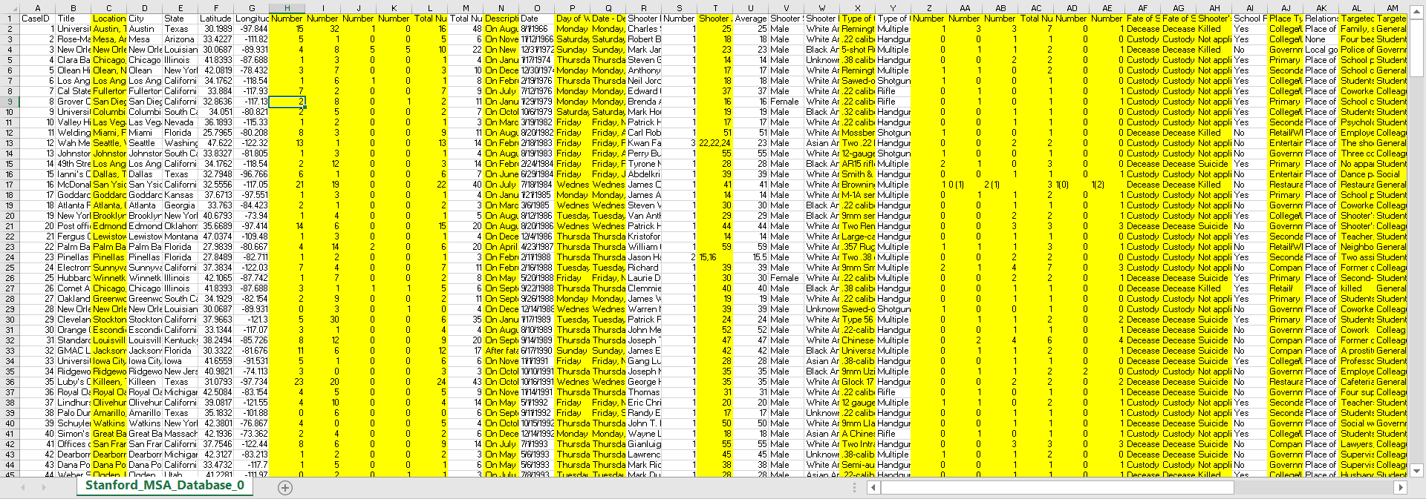
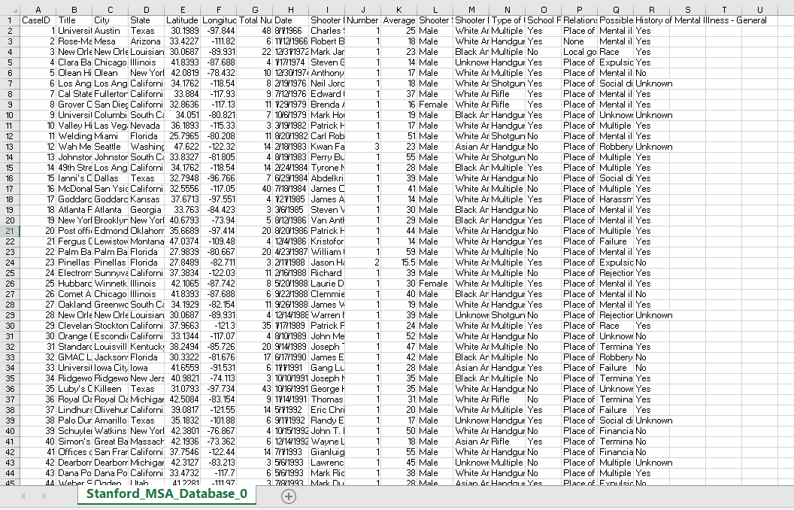
Removed Irrelevant Columns

Slide 10
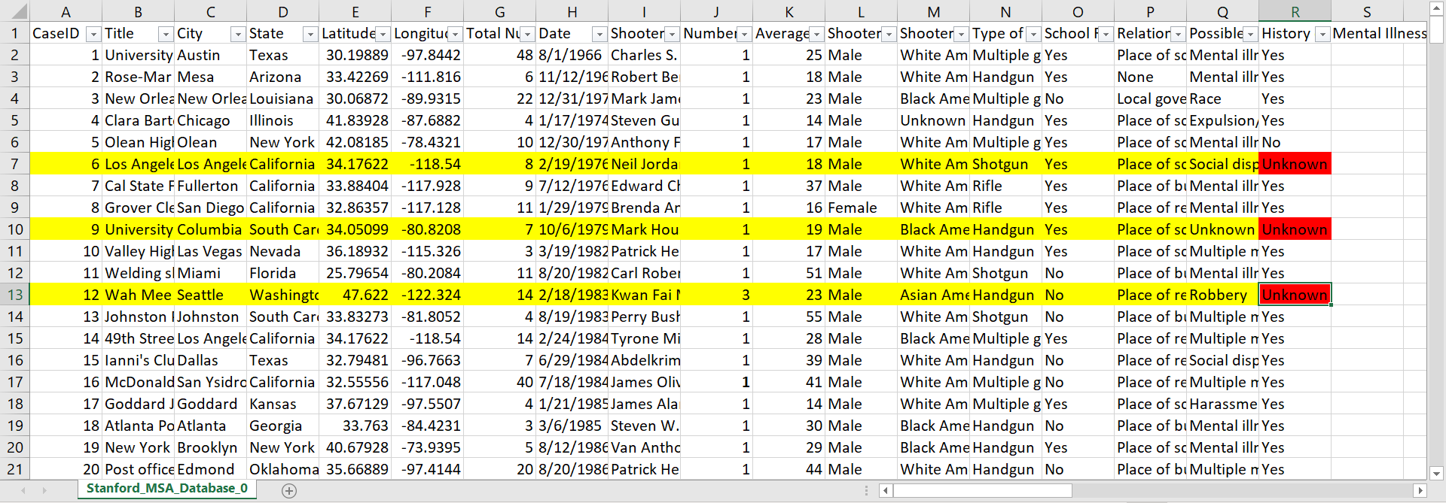
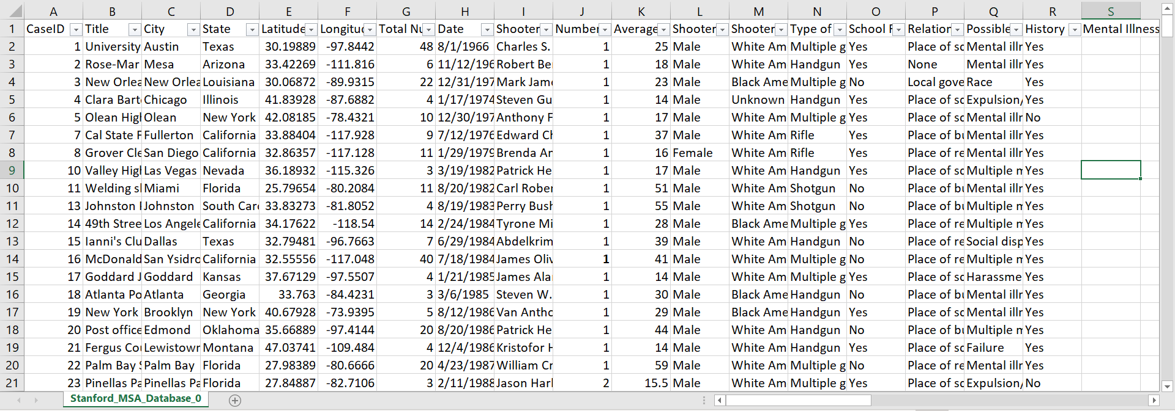
Removed Rows containing “Unknown” values in the History of Mental Illness - General column

Slide 11
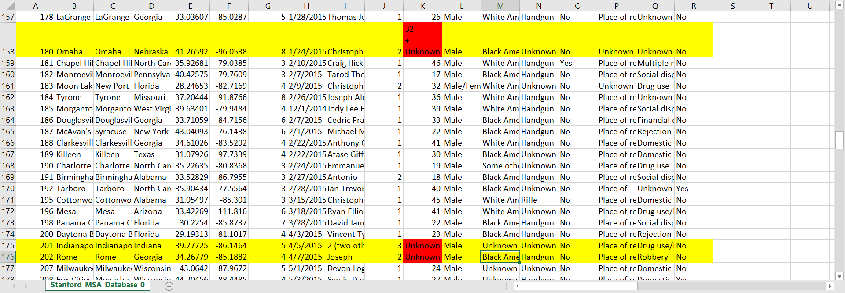
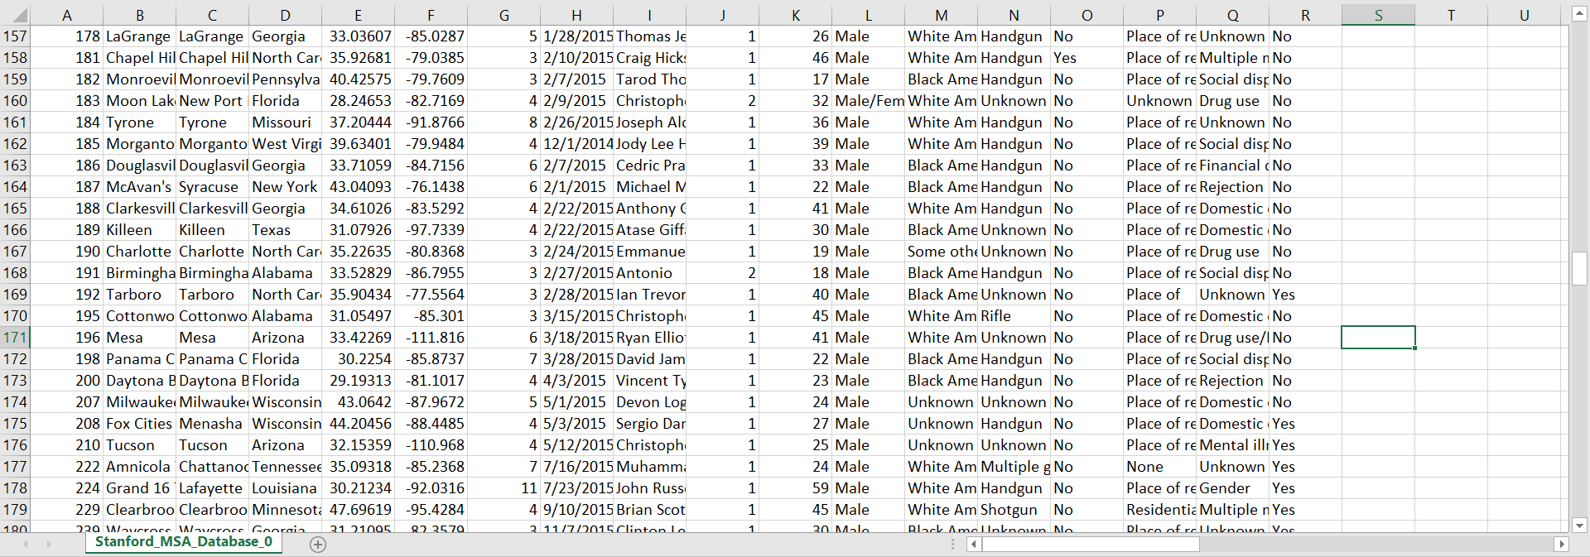
Removed Rows with “Unknown” values in the Average Shooter Age Column

Slide 12
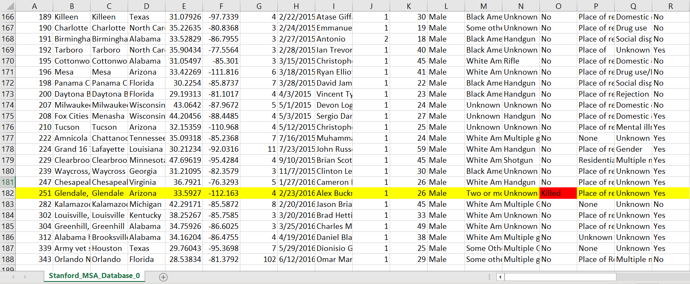
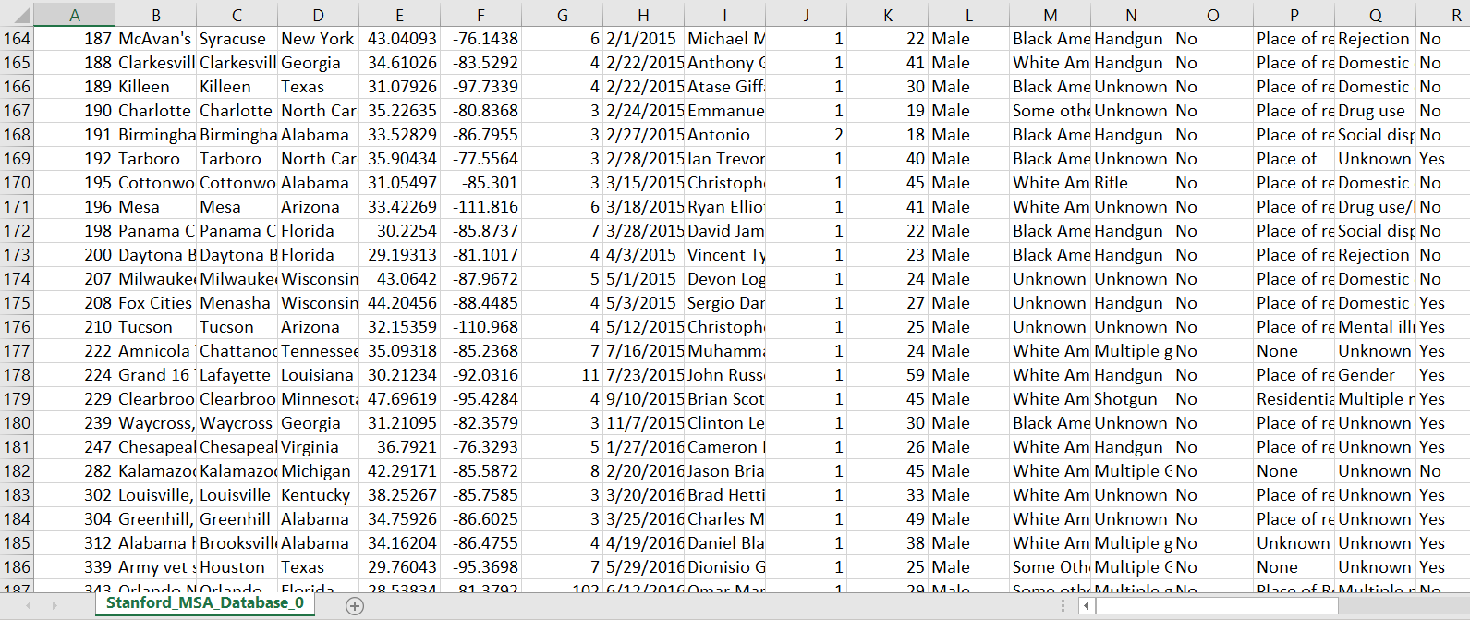
Removed Rows Containing “Killed” in the School Related Column

Slide 13
Questions and Visualizations

Slide 14
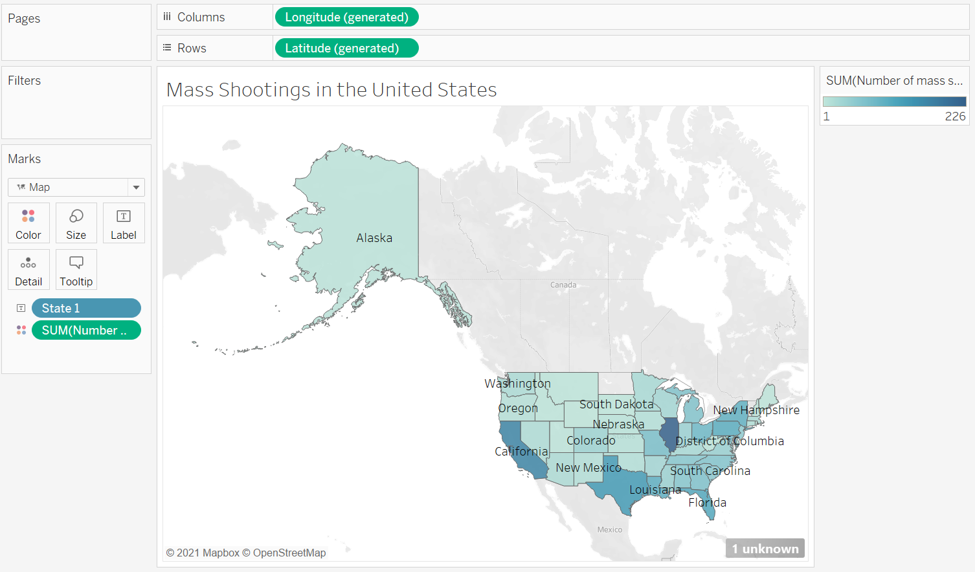

Which state has the most mass shootings?

Slide 15
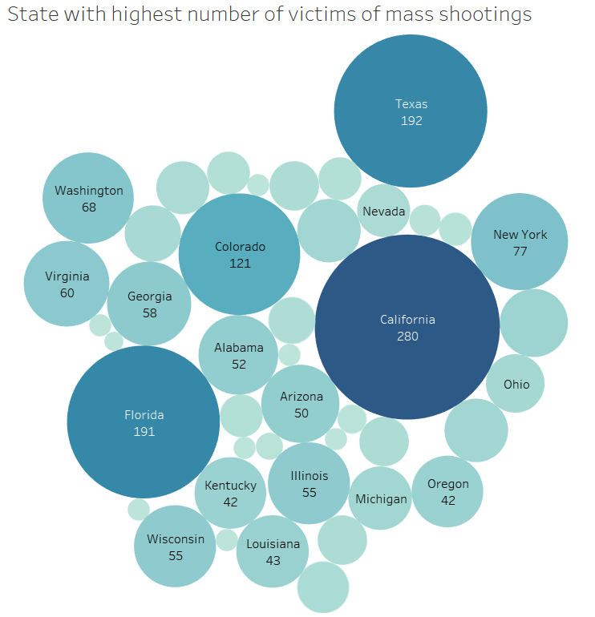

Which states have the highest number of victims of mass shootings?

Slide 16
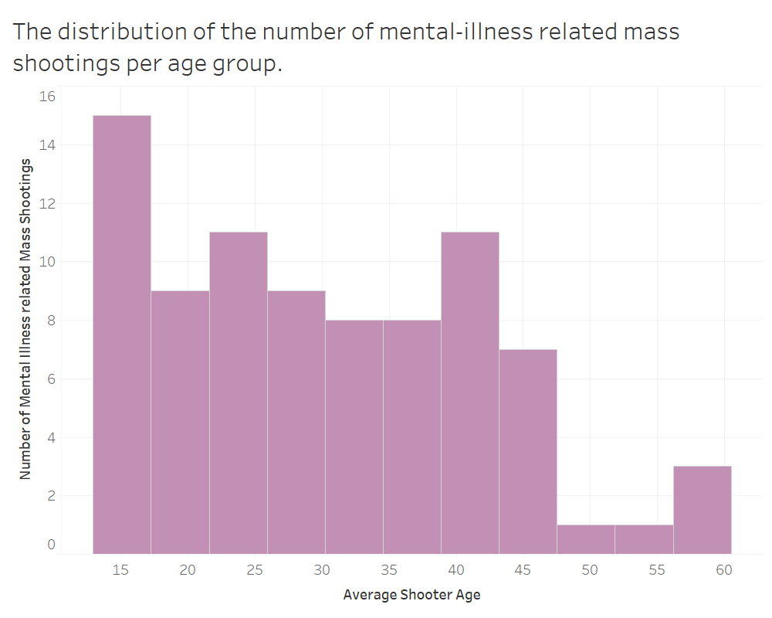
What is the age of the shooter where there is a maximum number of mental-illness-related shootings?

Slide 17
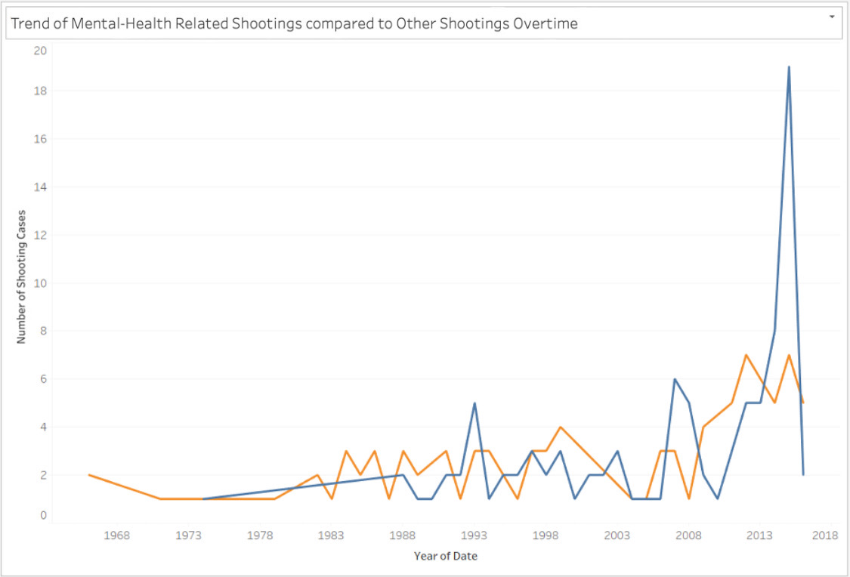
What is the trend of mental health-related shootings in comparison to other shootings over time?

Slide 18
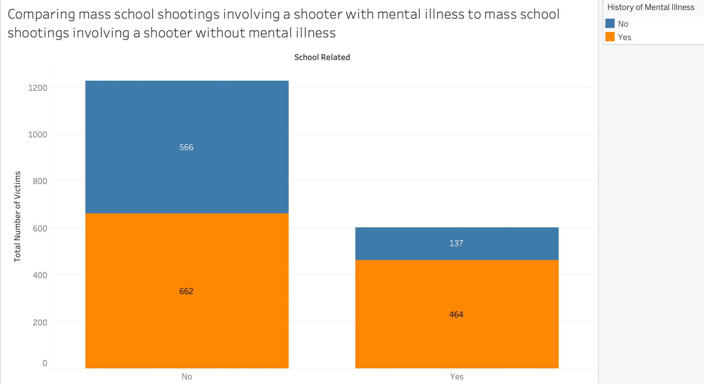
Are there more mental-illness-and-school related shooting incidents than non mental-illness-and-school related shooting incidents?
Notes:
This visualization compares school-related mass shooting incidents involving a shooter with a history of mental illness and school-related mass shooting incidents involving a shooter without a history of mental illness.
A stacked bar graph was selected to demonstrate the findings/values from the data set since this question necessitates a part-to-whole comparison of numeric values over a single categorical property.
The parts – history of mental illness and the environment of the shooting – to the whole – the total number of victims.
There are three attributes:
the first attribute, school-related incidents, is represented on the X-axis.
The second attribute, the total number of victims from mass shootings in general, is represented on the Y-axis.
The third attribute, the shooter’s mental illness status, is represented by two different colors: orange for yes and blue for no. The use of contrasting colors is intentional since the Stanford MSA database generalizes all mental illnesses into a simple yes or no.
From this visualization, we can see that the number of victims in a school shooting where the shooter has a history of mental illness sits at 464, and the number of victims in a school shooting where the shooter does not have a history of mental illness sits at 137.
On the other hand, the number of victims in a non-school-related shooting where the shooter has a history of mental illness sits at 662, and the number of victims in a non-school-related shooting where the shooter does not have a history of mental illness sits at 566.
From this visualization, we can conclude that mental illness is not a causal attribute to mass shootings in general, however, the likelihood of a school shooter having a history of mental illness is greater than in any other setting.

Slide 19
It is crucial to state that there is no clear line we can draw to connect the history of mental health of the shooter to the shooting incident itself, nor can we draw a connection between the two attributes as a cause or effect of each other.

Slide 20
Any Questions?

Slide 21
Thank You!

